Slide 1

Web development
Success Outcomes:
Students will be able to describe what HTML is and its role in web development.
Students will learn basic HTML tags
Students will learn how to identify some tags used in an actual website’s source code
Students will learn some basic CSS skills
Students will learn to produce their own websites
TOPIC: Web design and development.
Lesson 2
The Grammar Way: Resilience

Slide 2
Starter/Reflection: You have been given a task to create a website that will advertise a bike racer for hire. Utilizing the skills learnt thus far, create a new webpage called “index.html” that will have two paragraphs. The first paragraph will briefly talk about the biker’s skills and the second will describe the bike.
Success Outcomes:
Students will be able to describe what HTML is and its role in web development.
Students will learn basic HTML tags
Students will learn how to identify some tags used in an actual website’s source code
Students will learn some basic CSS skills
Students will learn to produce their own websites
TOPIC: Web design and development.
The Grammar Way: Resilience
Notes:
The reason why we will use index.html as the name is because when you upload your website to a webserver, the first thing it looks for is the index.html file.

Slide 3


Success Outcomes:
Students will be able to describe what HTML is and its role in web development.
Students will learn basic HTML tags
Students will learn how to identify some tags used in an actual website’s source code
Students will learn some basic CSS skills
Students will learn to produce their own websites
TOPIC: Web design and development.
Artwork
Print Shop
The Grammar Way: Resilience

Slide 4


Success Outcomes:
Students will be able to describe what HTML is and its role in web development.
Students will learn basic HTML tags
Students will learn how to identify some tags used in an actual website’s source code
Students will learn some basic CSS skills
Students will learn to produce their own websites
TOPIC: Web design and development.
The Grammar Way: Resilience

Slide 5



Success Outcomes:
Students will be able to describe what HTML is and its role in web development.
Students will learn basic HTML tags
Students will learn how to identify some tags used in an actual website’s source code
Students will learn some basic CSS skills
Students will learn to produce their own websites
TOPIC: Web design and development.
Web Server
www.google.com
Client
The Grammar Way: Resilience

Slide 6
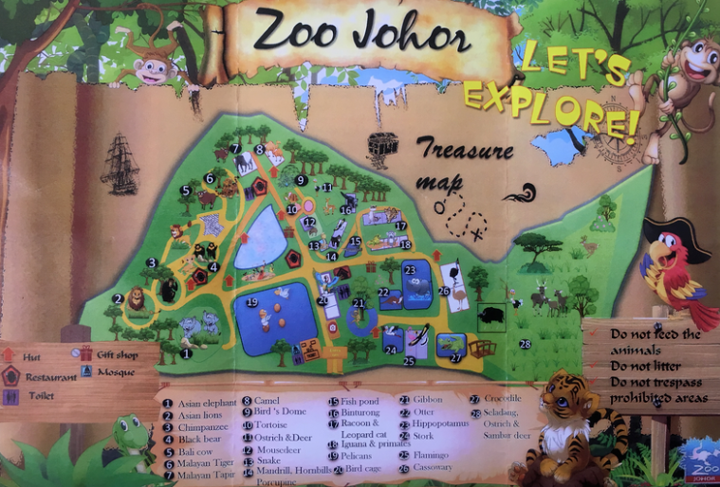
Success Outcomes:
Students will be able to describe what HTML is and its role in web development.
Students will learn basic HTML tags
Students will learn how to identify some tags used in an actual website’s source code
Students will learn some basic CSS skills
Students will learn to produce their own websites
TOPIC: Web design and development.
Imagine this zoo or a school that you have never been to. You have no idea about
where anything is. Where would you first go to?
You will go to the information centre, help desk at entry etc.
The Grammar Way: Resilience
Notes:
Imagine this zoo or a school that you have never been to. You have no idea about where anything is. Where would you first go to?
Answer: Information centre, help desk at entry etc.

Slide 7
Success Outcomes:
Students will be able to describe what HTML is and its role in web development.
Students will learn basic HTML tags
Students will learn how to identify some tags used in an actual website’s source code
Students will learn some basic CSS skills
Students will learn to produce their own websites
TOPIC: Web design and development.
Web Server
Similarly in a website, the web server also needs a landing page(Information centre). This file is named “index.html”. This will guide the clients to where ever they need to go.
The Grammar Way: Resilience
Notes:
Similarly in a website, the web server also needs a landing page(Information centre). This file is named “index.html”. This will guide the clients to where ever they need to go.

Slide 8
Task
Success Outcomes:
Students will be able to describe what HTML is and its role in web development.
Students will learn basic HTML tags
Students will learn how to identify some tags used in an actual website’s source code
Students will learn some basic CSS skills
Students will learn to produce their own websites
TOPIC: Web design and development.
Go to Student Distribution -> Technology -> Form 3 -> ICT
Open the pdf file called “Instructions on uploading website”
Once completed send the link to [teacher’s email] s.Qadir@ags.school.nz
The Grammar Way: Resilience

Slide 9
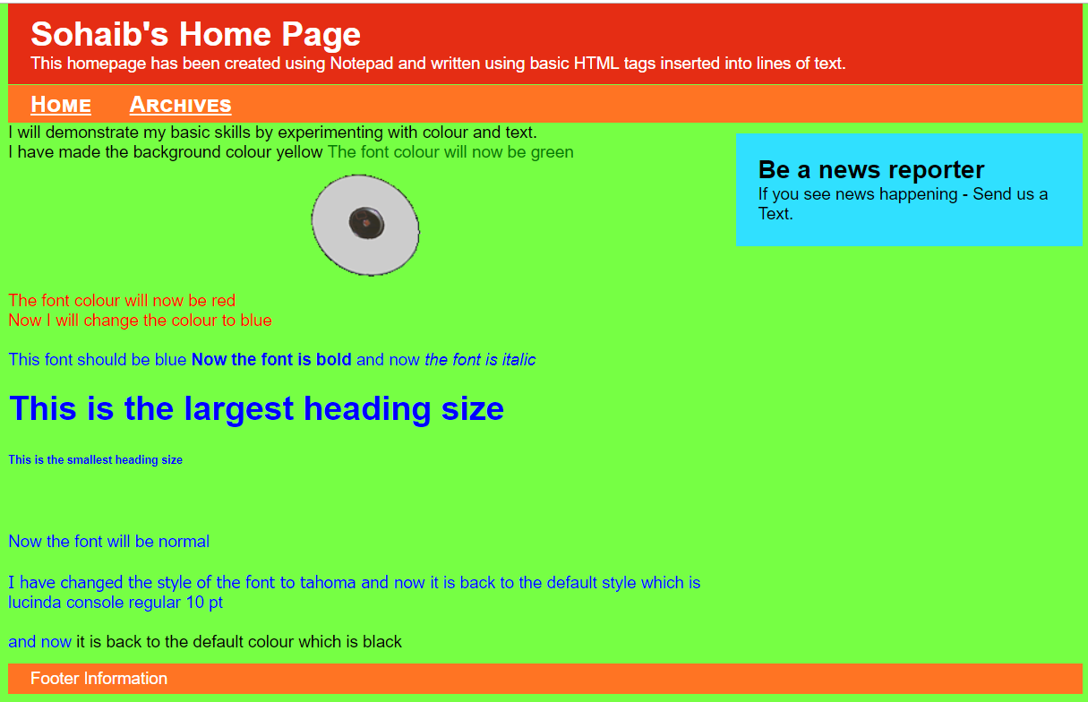
Structural Tags(body)
Success Outcomes:
Students will be able to describe what HTML is and its role in web development.
Students will learn basic HTML tags
Students will learn how to identify some tags used in an actual website’s source code
Students will learn some basic CSS skills
Students will learn to produce their own websites
TOPIC: Web design and development.
<NAV>
This is where you put your navigation bar.
</NAV>
<MAIN>
This is where the main part of your body goes
</MAIN>
<FOOTER>
This typically contains copyright and authorship information</FOOTER>
The Grammar Way: Resilience

Slide 10
<body>
<NAV>
</NAV>
<MAIN>
</MAIN>
<FOOTER>
</FOOTER>
<body>

Slide 11
Formatting Tags
Success Outcomes:
Students will be able to describe what HTML is and its role in web development.
Students will learn basic HTML tags
Students will learn how to identify some tags used in an actual website’s source code
Students will learn some basic CSS skills
Students will learn to produce their own websites
TOPIC: Web design and development.
Formatting Tags -- Used for formatting text in the website. Some common ones are:
<b> Bold, <i>Italic, <sub>_{subscript}, <sup>^{superscript}, and header tags(next page)
Although styling is primarily used for formatting elements, there are a few tags that can format elements.
The Grammar Way: Resilience
Notes:
Although styling is primarily used for formatting elements, there are a few tags that can format elements.

Slide 12
Header Tags
Success Outcomes:
Students will be able to describe what HTML is and its role in web development.
Students will learn basic HTML tags
Students will learn how to identify some tags used in an actual website’s source code
Students will learn some basic CSS skills
Students will learn to produce their own websites
TOPIC: Web design and development.
Header Tags -- Used for marking sections and subsections in a document.
H1 = Giant-sized and bold
H2 = Large and bold
H3 = Normal-sized and bold
H4 = Small and bold
H5 = Very Small and bold
H6 = Tiny and bold
The Grammar Way: Resilience

Slide 13
Line Breaks and Paragraphs
Success Outcomes:
Students will be able to describe what HTML is and its role in web development.
Students will learn basic HTML tags
Students will learn how to identify some tags used in an actual website’s source code
Students will learn some basic CSS skills
Students will learn to produce their own websites
TOPIC: Web design and development.
<P> text </P>
Paragraph tag
Most browsers render (process) this with blank lines between each paragraph
<BR>
Line break tag
Used when we want to go to the next line but don't want a blank line to follow
<HR>
Creates a horizontal line
The Grammar Way: Resilience

Slide 14
Lists
Success Outcomes:
Students will be able to describe what HTML is and its role in web development.
Students will learn basic HTML tags
Students will learn how to identify some tags used in an actual website’s source code
Students will learn some basic CSS skills
Students will learn to produce their own websites
TOPIC: Web design and development.
Unordered HTML List
An unordered list starts with the <ul> tag. Each list item starts with the <li> tag.
The list items will be marked with bullets (small black circles) by default. Ordered lists are similar to unordered lists. The only difference is that they start with <ol> ag and are marked with numbers instead of bullets.
Example:
<ul> <li>Coffee</li> <li>Tea</li> <li>Milk</li> </ul>
The Grammar Way: Resilience

Slide 15
Tables
Success Outcomes:
Students will be able to describe what HTML is and its role in web development.
Students will learn basic HTML tags
Students will learn how to identify some tags used in an actual website’s source code
Students will learn some basic CSS skills
Students will learn to produce their own websites
TOPIC: Web design and development.
An HTML table is defined with the <table> tag.
Each table row is defined with the <tr> tag. A table header is defined with the <th> tag.
By default, table headings are bold and centered. A table data/cell is defined with the <td> tag.
The Grammar Way: Resilience

Slide 16
Attributes
Success Outcomes:
Students will be able to describe what HTML is and its role in web development.
Students will learn basic HTML tags
Students will learn how to identify some tags used in an actual website’s source code
Students will learn some basic CSS skills
Students will learn to produce their own websites
TOPIC: Web design and development.
All HTML elements can have attributes
Attributes provide additional information about an element
Attributes are always specified in the start tag
Attributes usually come in name/value pairs like: name="value"
The Grammar Way: Resilience

Slide 17
Common attributes
Success Outcomes:
Students will be able to describe what HTML is and its role in web development.
Students will learn basic HTML tags
Students will learn how to identify some tags used in an actual website’s source code
Students will learn some basic CSS skills
Students will learn to produce their own websites
TOPIC: Web design and development.
The title attribute provides additional "tool-tip" information
The href attribute provides address information for links
The width and height attributes provide size information for images
The alt attribute provides text for screen readers
The Grammar Way: Resilience

Slide 18
Links and images
Success Outcomes:
Students will be able to describe what HTML is and its role in web development.
Students will learn basic HTML tags
Students will learn how to identify some tags used in an actual website’s source code
Students will learn some basic CSS skills
Students will learn to produce their own websites
TOPIC: Web design and development.
<a href=“link/file_path”>text to display</a>
<img src=“link or file_path or name_of_image.file_type”>
The Grammar Way: Resilience

Slide 19
Using the skills learnt and the w3schools website for reference, emulate the screenshot on the next page. Your webpage should have formatting that resembles the formatting of the webpage screenshot.
Success Outcomes:
Students will be able to describe what HTML is and its role in web development.
Students will learn basic HTML tags
Students will learn how to identify some tags used in an actual website’s source code
Students will learn some basic CSS skills
Students will learn to produce their own websites
TOPIC: Web design and development.
The Grammar Way: Resilience
Notes:
The point of this is not to make a fancy webpage. We will learn how to make our web page look better using CSS.

Slide 20
